Slide 1
Chapter 45 The Nature of Light

Slide 2
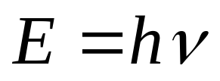
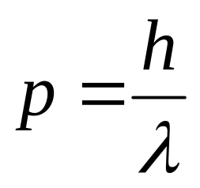
Interference
Wave (electromagnetic wave)
Diffraction
Polarization
Light
Compton Effect
Particle (photon)
Black-body radiation
Photoelectric Effect
proposed by Einstein in 1905
energy
h Planck constant
h=6.63×10⁻³⁴ J·s
momentum

Slide 3
Wave (electromagnetic wave)
Light
Particle (photon)
Light is both a particle and a wave.
Light is neither a classical particle nor a classical wave.

Slide 4
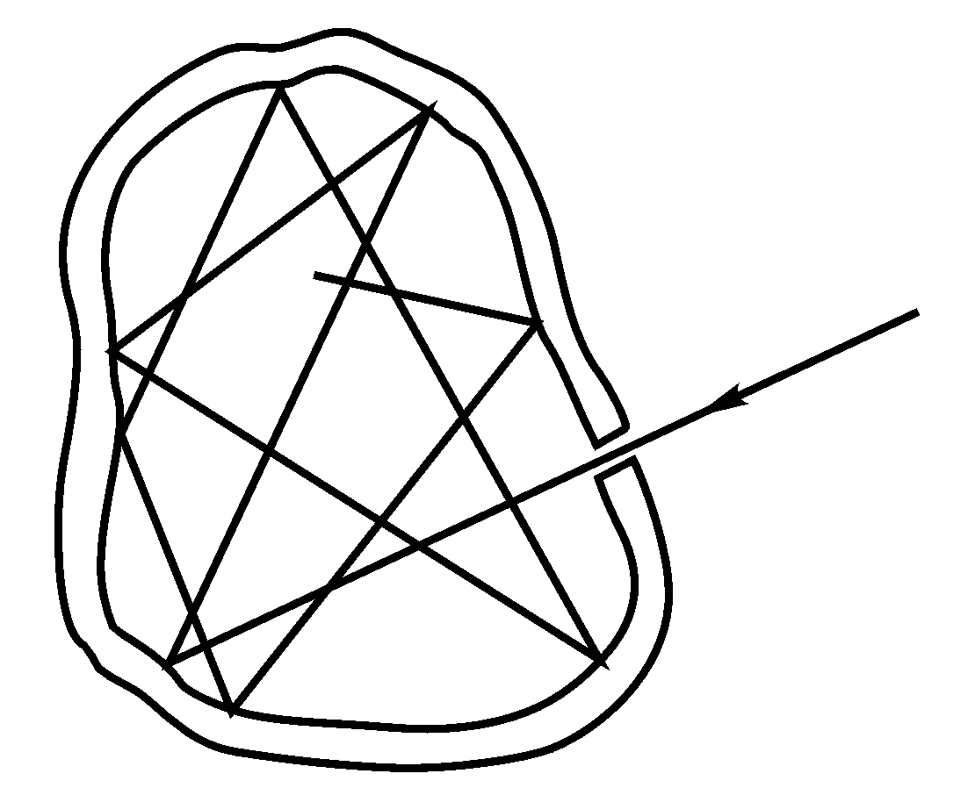


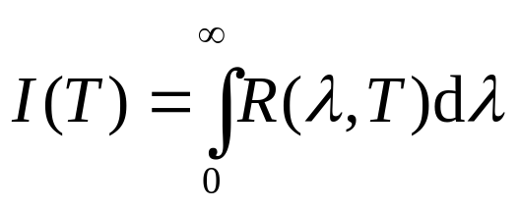
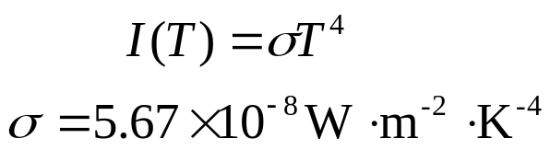

Black-body radiation
Cavity radiation:
The radiation emerging from the hole should not depend on the material or the mode of construction of cavity but only on the temperature.
Thermal Radiation
total power per area
Stefan-Boltzmann law
radiation emitted by a body because of its temperature.

Slide 5
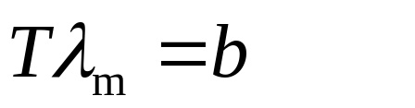

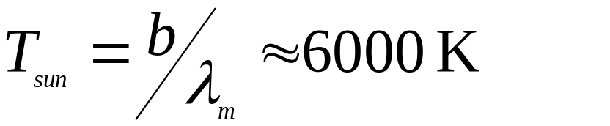
increasing T
Wien displacement law
With a λ_{m} of 500 nm for sun radiation, the temperature of sun:

Slide 6
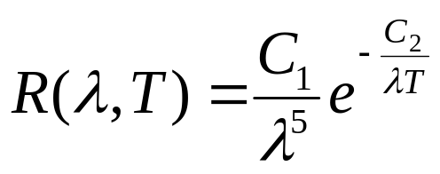
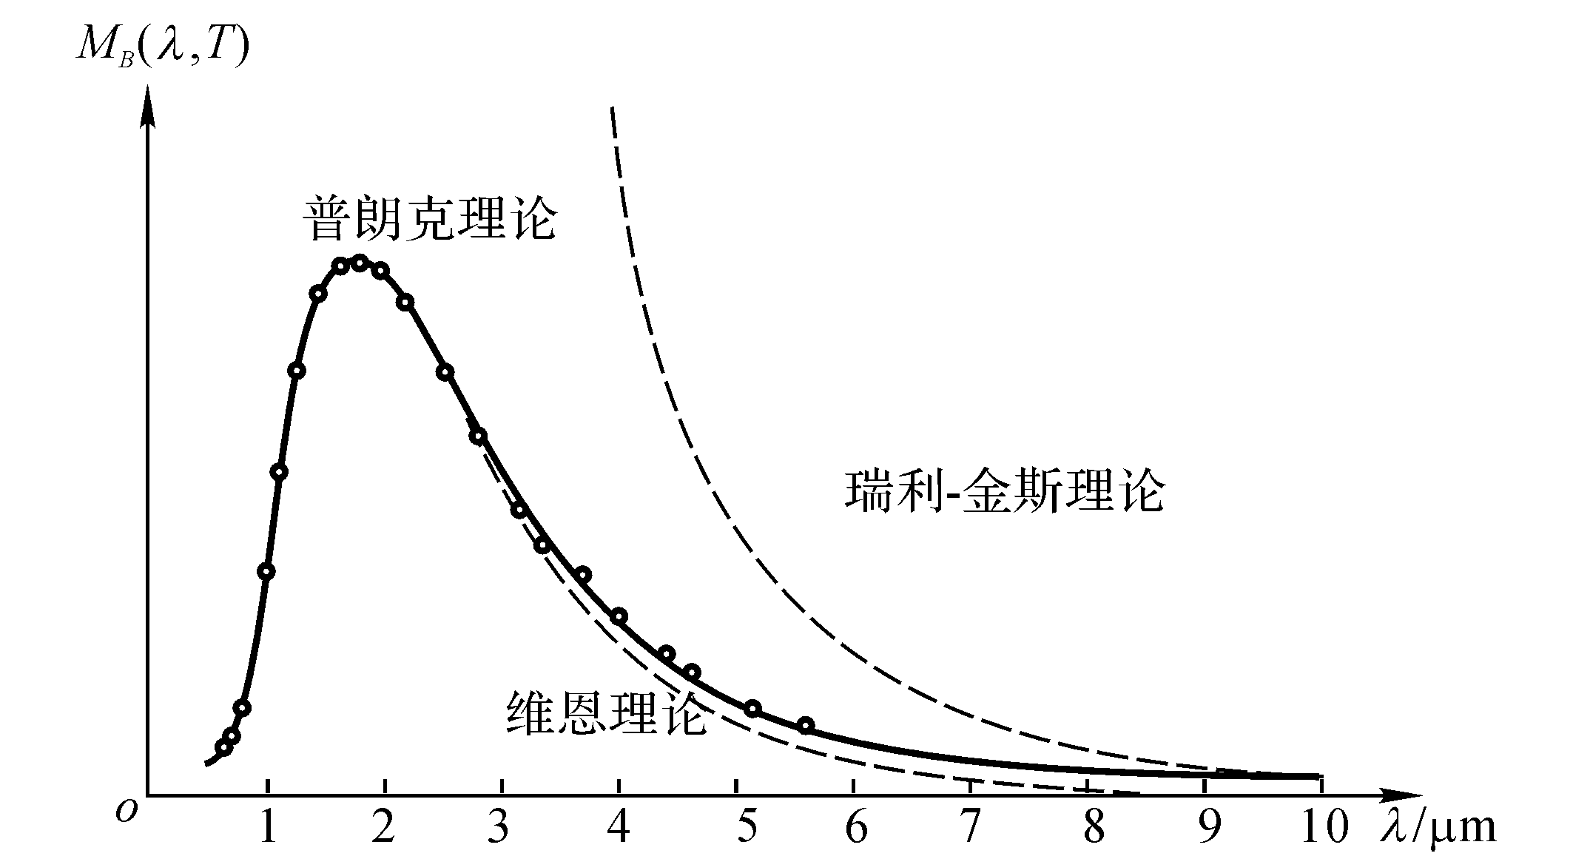
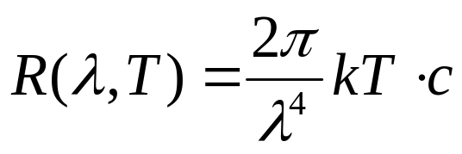
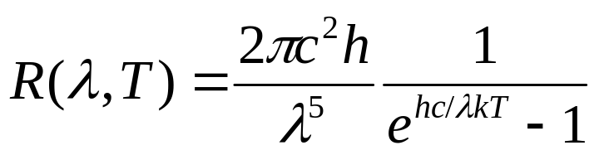
Find the function R(λ,T) with λ.
Wien’s formula
R(λ,T)
Planck’s radiation law
Rayleigh-Jeans’ formula
Rayleigh-Jeans’ formula
Planck’s radiation law (1900)
Wien’s formula
Max Planck assumed energy of harmonic oscillator is quantized. E = hv
h=6.626 ×10⁻³⁴ Joule sec

Slide 7
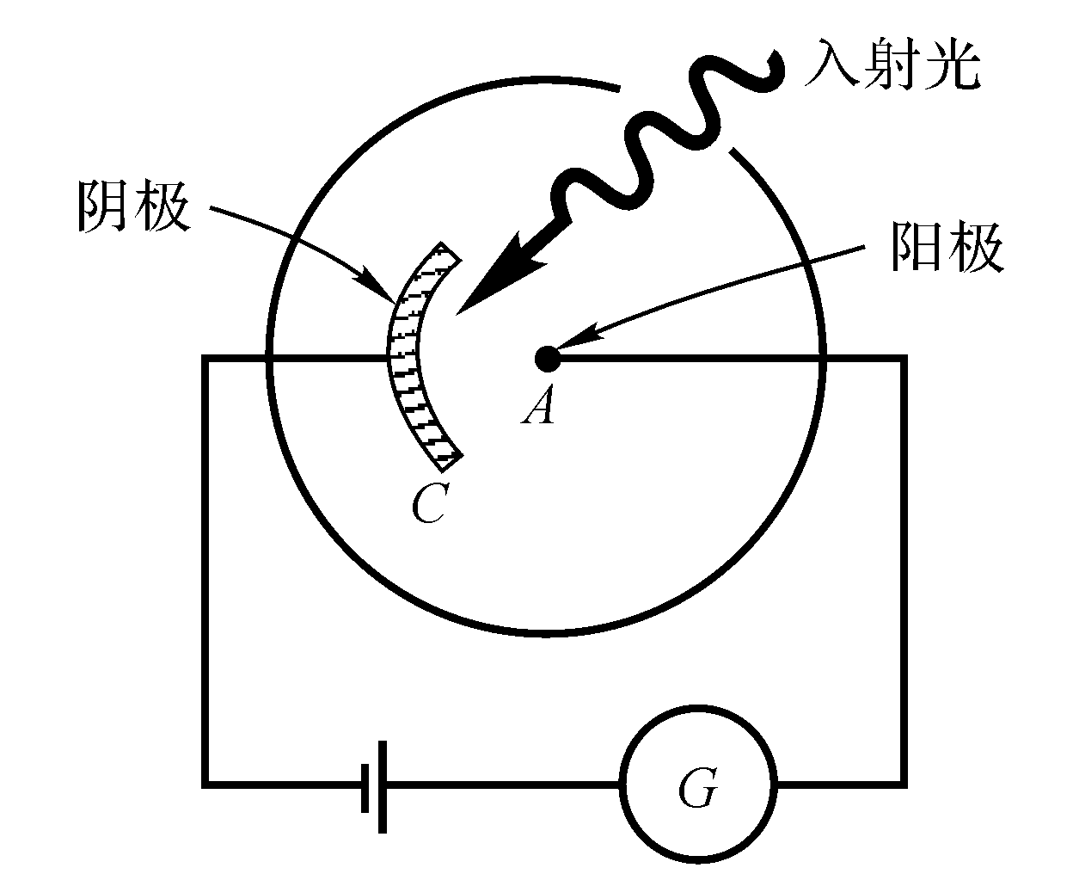
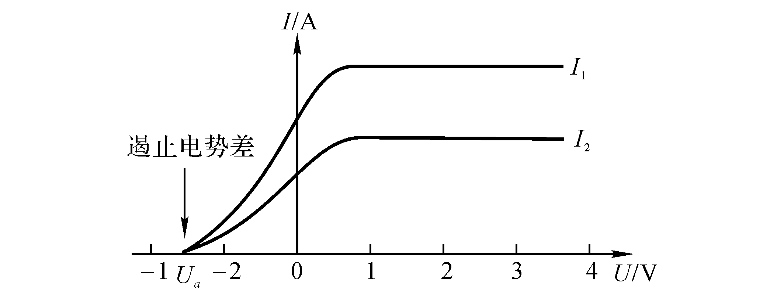
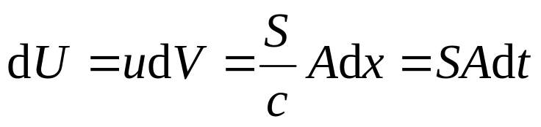


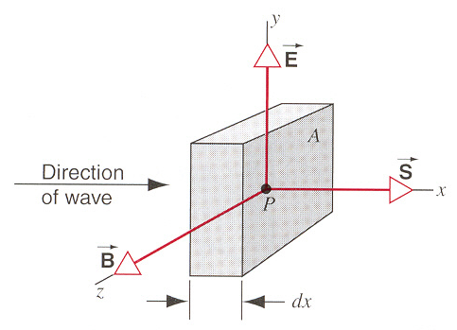
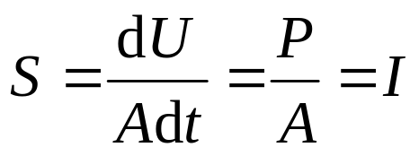
The Photoelectric Effect
Negative pole
positivepole
Problems facing to classical physics
1. Intensity problem
If light of a given wavelength falls on a given emitter, the stopping potential does not depend on the intensity of the incident light. (stopping potential)
stopping potential
₀

Slide 8
The Photoelectric Effect
Negative pole
positivepole
Problems facing to classical physics
2. Frequency problem
The frequency of the light must be greater than a certain value f₀. Otherwise the photoelectric effect will not occur. (cutoff frequency)
3. Time delay problem
Photoelectrons are emitted without delay once the incident light reaches the surface of the emitter. (<10⁻⁹ s)
stopping potential
₀
S is dependent on E and B but not on the frequency of the light

Slide 9
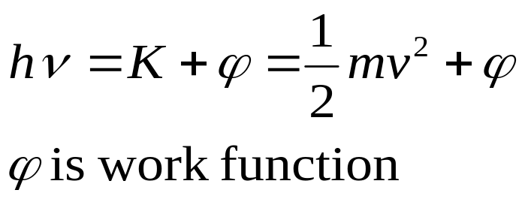
Einstein’s analysis of the photoelectric effect
Light quantum (later comes photon) was first introduced by Einstain
Negative pole
positivepole
Intensity of light, the number of photon, but the energy of a photon is the same.
stopping potential
₀

Slide 10


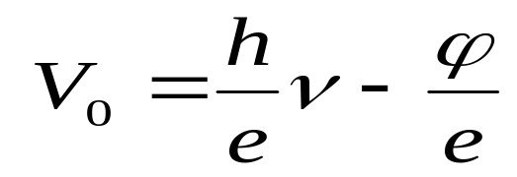
Einstein’s analysis of the photoelectric effect
Light quantum (later comes photon) was first introduced by Einstain
Negative pole
positivepole
Stopping potential
stopping potential
₀

Slide 11
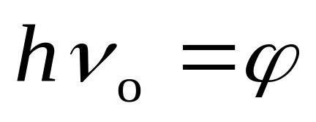
Einstein’s analysis of the photoelectric effect
Light quantum (later comes photon) was first introduced by Einstain
Negative pole
positivepole
Cut off frequency
stopping potential
₀

Slide 12
Einstein’s analysis of the photoelectric effect
Light quantum (later comes photon) was first introduced by Einstain
Negative pole
positivepole
Time delay problem
A single photon carries an energy hν into the emitter, where it is transferred to a single electron. There is no time delay.
stopping potential
₀

Slide 13
Max Planck assumed energy of harmonic oscillator is quantized. E = hv
h=6.626 ×10⁻³⁴ Joule sec
More proof
the beginning of the full development of quantum physics.

Slide 14
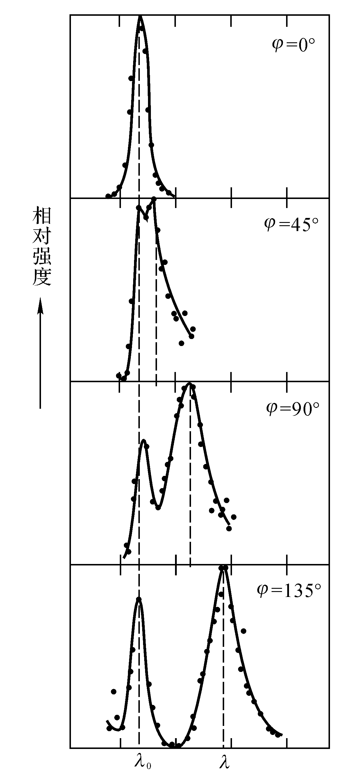
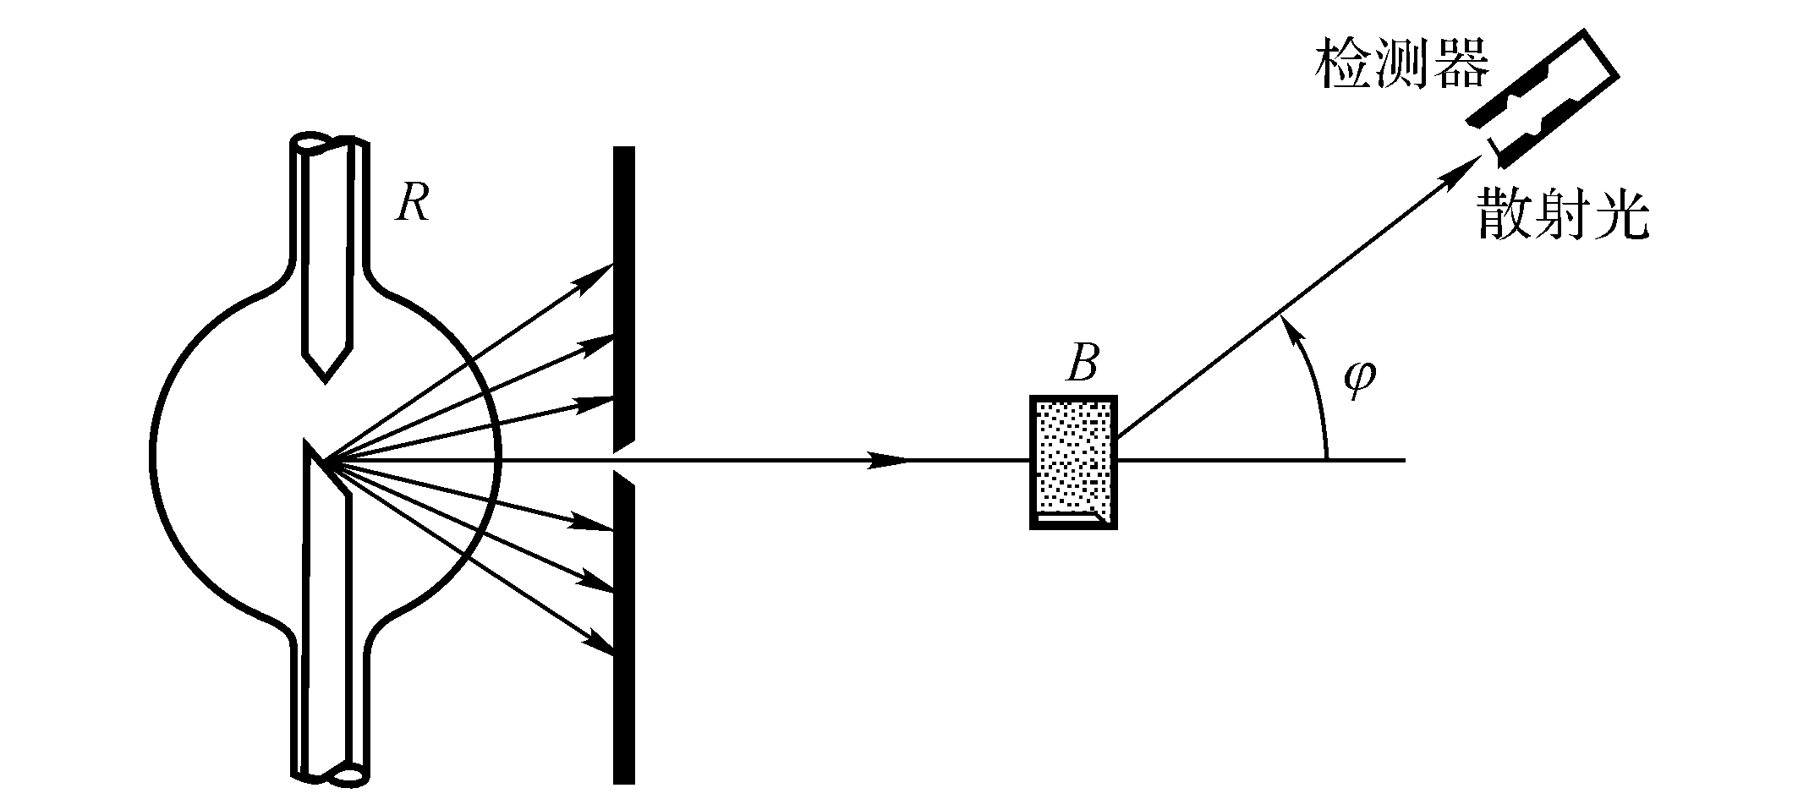
The Compton Effect
intensity
The scattered x ray have intensity peaks at two wavelengths, λ and λ´, λ´- λ= Δλ>0. Δλ varies with the angle φ.

Slide 15



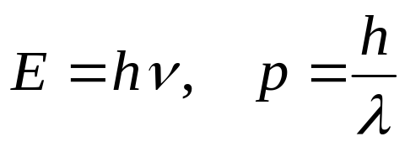



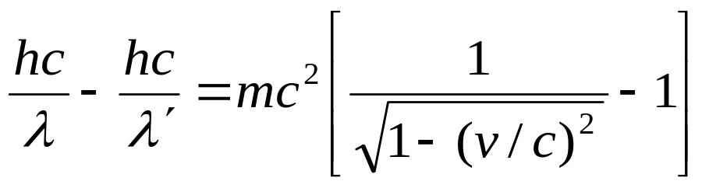
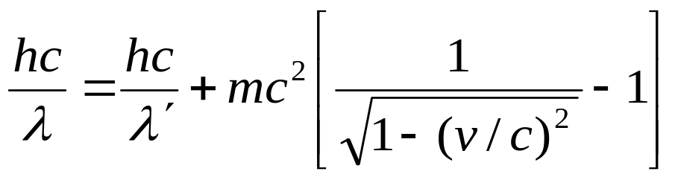
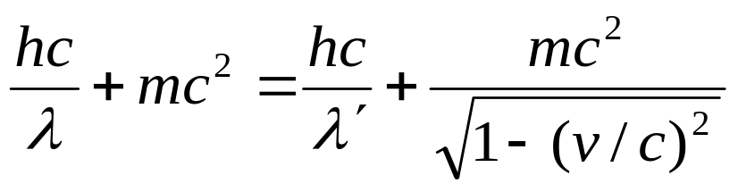
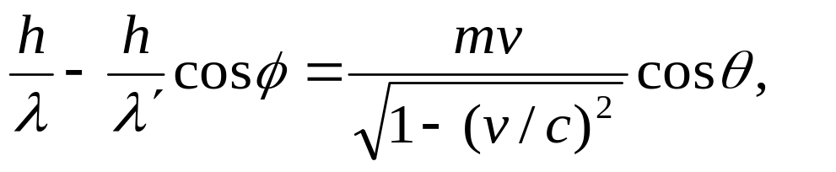

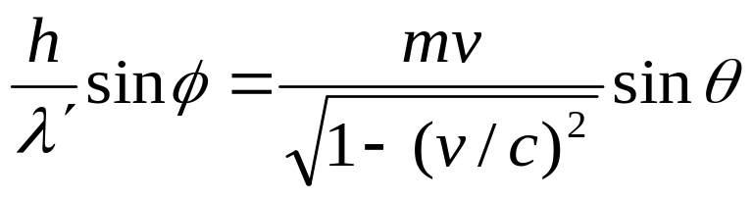
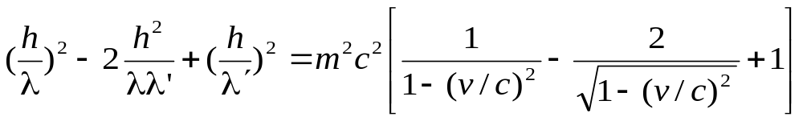
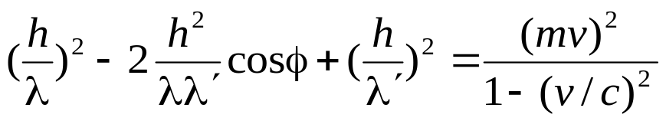
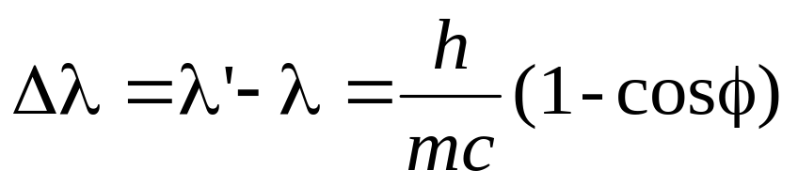
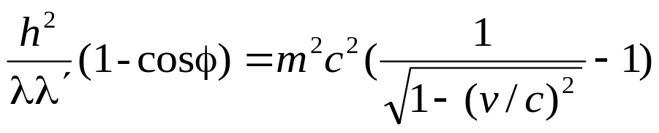
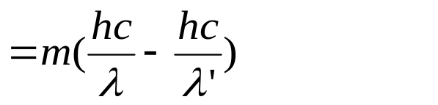
Photon is already particle:
Scattering by electron:

Slide 16
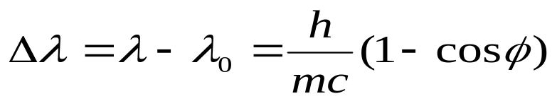

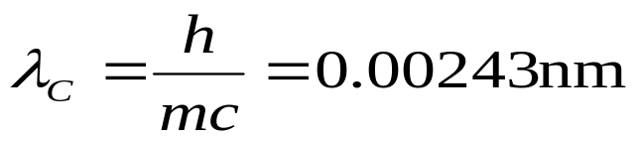
The Compton Effect
intensity
Δλ does not depend on the wavelength λ of the incident radiation.

Slide 17
Black-body radiation
photoelectric effect
Compton Effect
Particle (photon)
Light
Wave (electromagnetic wave)
Interference
Diffraction
Polarization

Slide 18
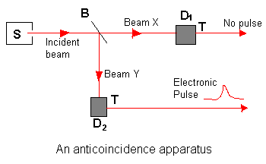
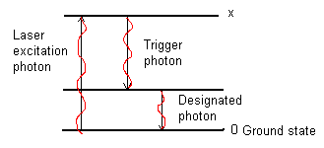
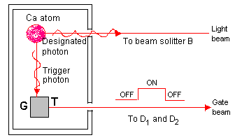
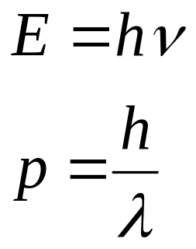
In 1986, P. Grangier et al made chief modification for source S:
The experiment worked brilliantly.

Slide 19
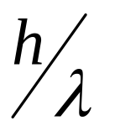

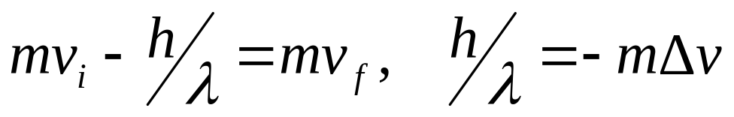
Slowing Down Atoms by Photon Bombardment
At room temperature v_{rms}=(3kT/m)^{1/2}=430m/s
The atoms can be slowed down from these high speeds by being bomdarded with photons. This will provide further direct and convincing experimental evidence of the validity of the photon concept.

Slide 20
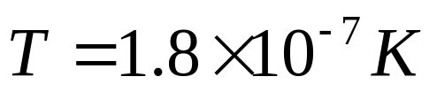


Laser cooling
Steven Chuet al shared the 1997 Nobel Prize in Physics “for development of method to cool and trap atoms with laser light”.
T=300K, v_{rms}=(3kT/m)^{1/2}=430m/s

Slide 21
Exercises
P1031-1032 11, 19, 21, 25, 31

